Slide 1
Scope of today’s work
Bomb calorimetry
Why enthalpy was invented
Entropy of phase transformations
How enthalpies of reaction tell us about entropy changes of the surroundings
2nd Law of Thermodynamics

Slide 2
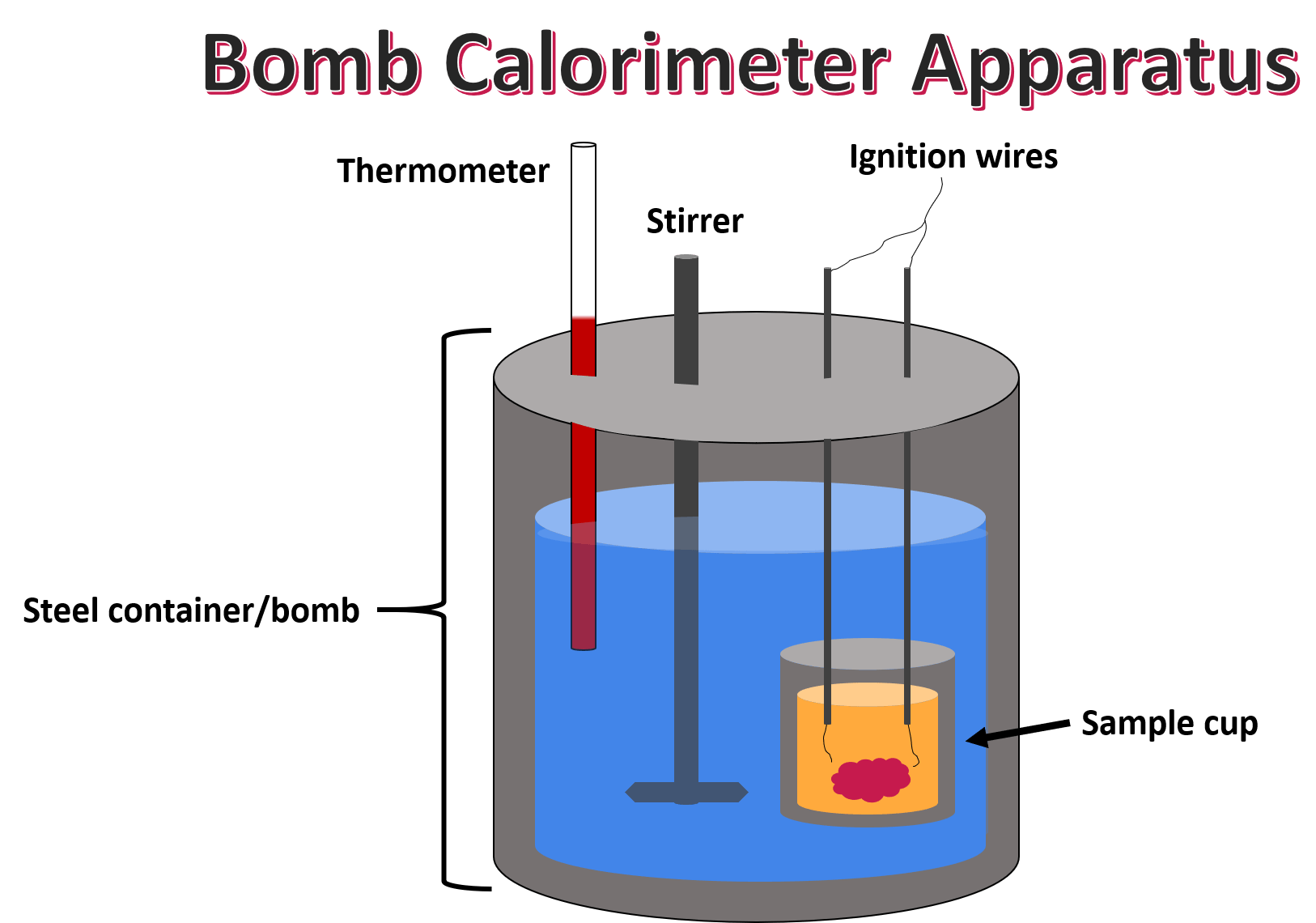

Bomb calorimeters tell us the heat ($q$) evolved during a chemical reaction
Reaction vessel
$$q$$

Slide 3

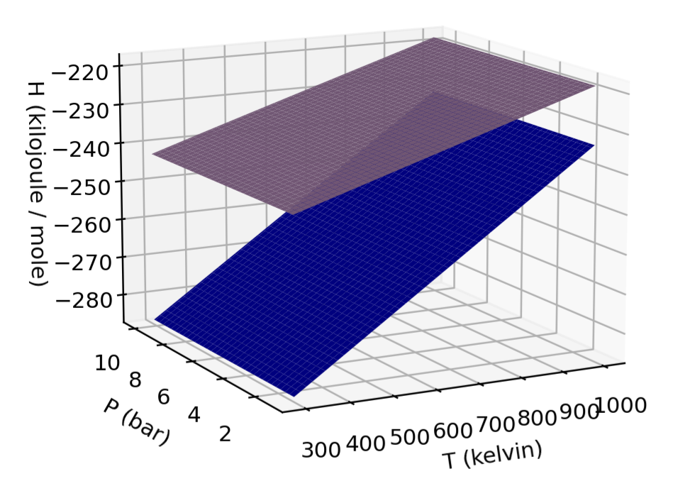


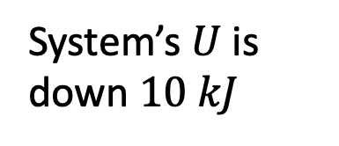
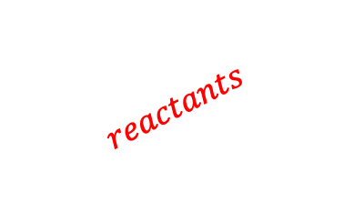
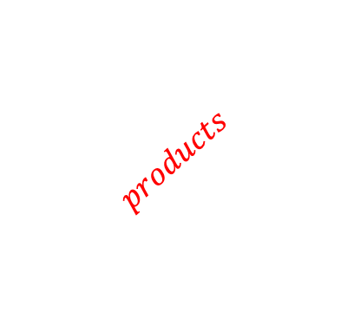

If the reaction takes place at a constant volume and temperature, $q$ tells us $∆U$
The 1st Law says $∆U=q+w$. When there’s no PV work done (no expansion or contraction), $∆U=q$.
System undergoes an exothermic reaction
System’s $U$ is down $10 kJ$
$$q=−10 kJ$$
$$∆U=q=−10 kJ$$
$$reactants$$
$$U(T,V)$$
$$products$$
Volume
Temperature

Slide 4




But what if the system can expand during a reaction (which is the typical case), $∆U≠q$
The 1st Law says $∆U=q+w$. Since there’s PV work done (expansion or contraction), $∆U≠q$.
System undergoes an exothermic reaction
System’s $U$ is down $10 kJ$ minus whatever work was done
$$q=−10 kJ$$
$$∆U≠−10 kJ$$
$$reactants$$
$$U(T,V)$$
$$products$$
Volume
Temperature

Slide 5


Enthalpy was invented so that $q$would tell us about changes in it: $∆H=q$
System undergoes an exothermic reaction
System’s $U$ is down $10 kJ$
$$q=−10 kJ$$
$$∆H=−10 kJ$$
$$reactants$$
$$H(T,P)$$
$$products$$
Pressure
Temperature

Slide 6
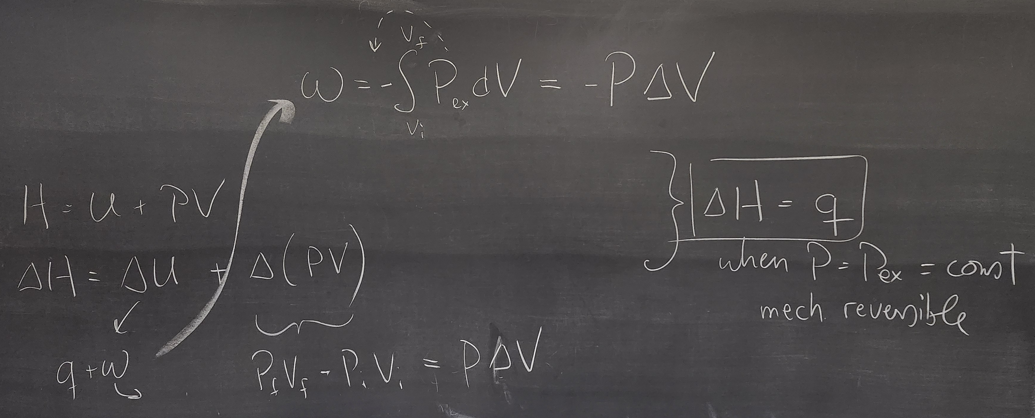


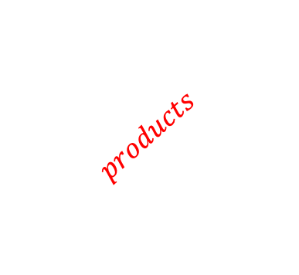
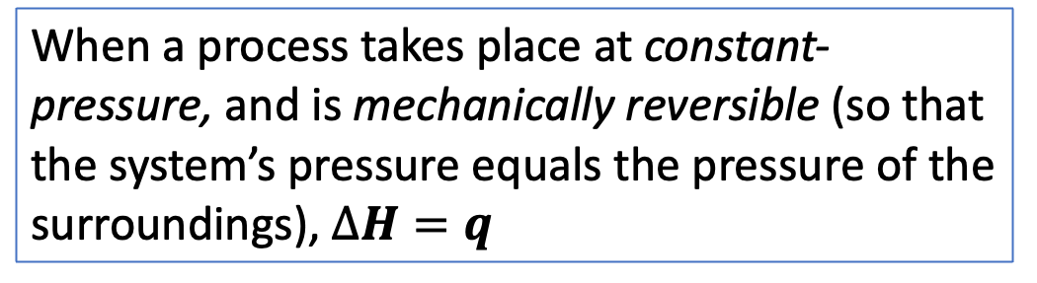
We already saw that $∆H=0$ in the adiabatic Joule-Thomson experiment. Here’s a sketch of a a more general proof about $∆H$ for chemical reactions that take place at a fixed pressure
When a process takes place at constant-pressure, and is mechanically reversible (so that the system’s pressure equals the pressure of the surroundings), $∆H=q$
$$reactants$$
$$H(T,P)$$
$$products$$
Pressure
Temperature

Slide 7
Scope of today’s work
Bomb calorimetry
Why enthalpy was invented
Entropy of phase transformations
How enthalpies of reaction tell us about entropy changes of the surroundings
2nd Law of Thermodynamics

Slide 8
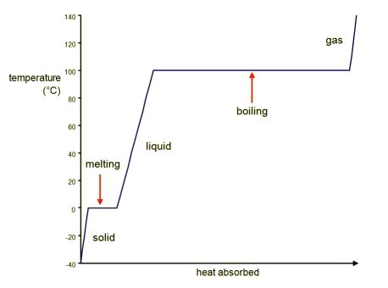
Today, the “chemical reactions” we’ll talk about are phase transformations
gas
gas
solid
solid
liquid
liquid

Slide 9
Today, the “chemical reactions” we’ll talk about are phase transformations
gas
gas
solid
solid
liquid
liquid

Slide 10
Today, the “chemical reactions” we’ll talk about are phase transformations
gas
gas
solid
solid
liquid
liquid

Slide 11
Today, the “chemical reactions” we’ll talk about are phase transformations
gas
gas
solid
solid
liquid
liquid

Slide 12
Today, the “chemical reactions” we’ll talk about are phase transformations
gas
gas
solid
solid
liquid
liquid

Slide 13
Today, the “chemical reactions” we’ll talk about are phase transformations
gas
gas
solid
solid
liquid
liquid

Slide 14
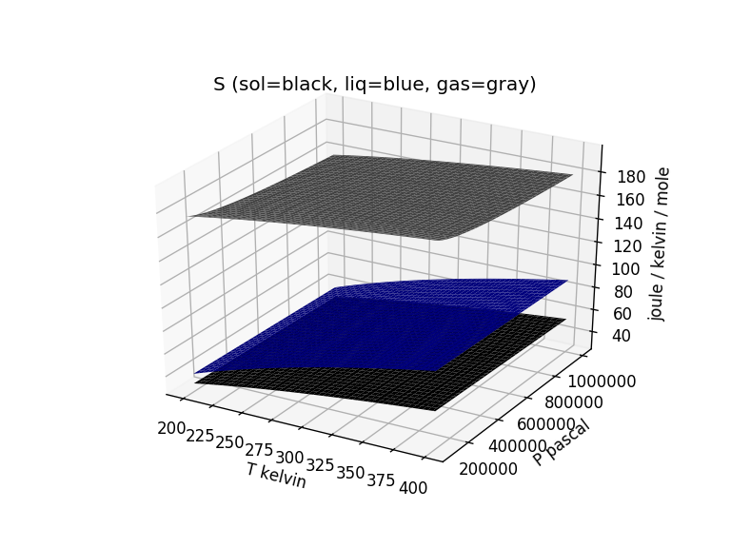


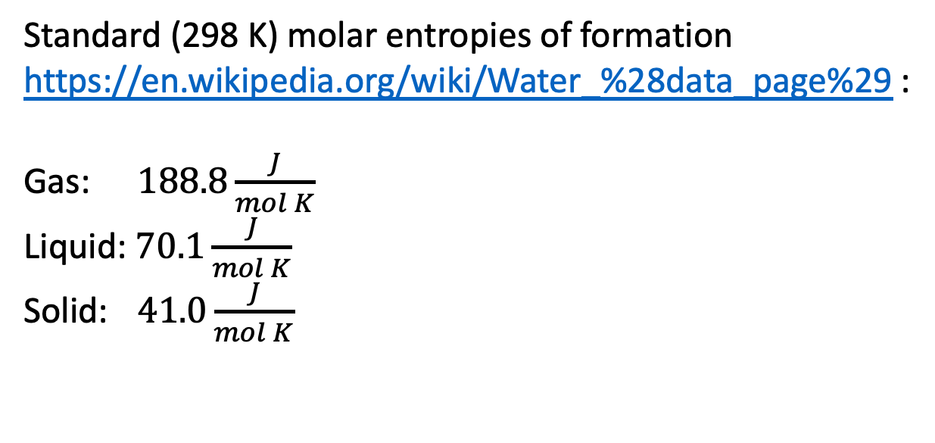

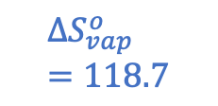

Entropy changes of the system: $∆S_{vap}$ at the standard-state temperature (298 K)
Standard (298 K) molar entropies of formation https://en.wikipedia.org/wiki/Water_%28data_page%29 :
Gas: $188.8\frac{J}{mol K}$
Liquid: $70.1\frac{J}{mol K}$
Solid: $41.0\frac{J}{mol K}$
$$188.8$$
$${∆S}_{vap}^{o}=118.7$$
$$∆S_{vap}^{o}=118.7 \frac{J}{mol K}$$
$$70.1$$
$$41.0$$

Slide 15
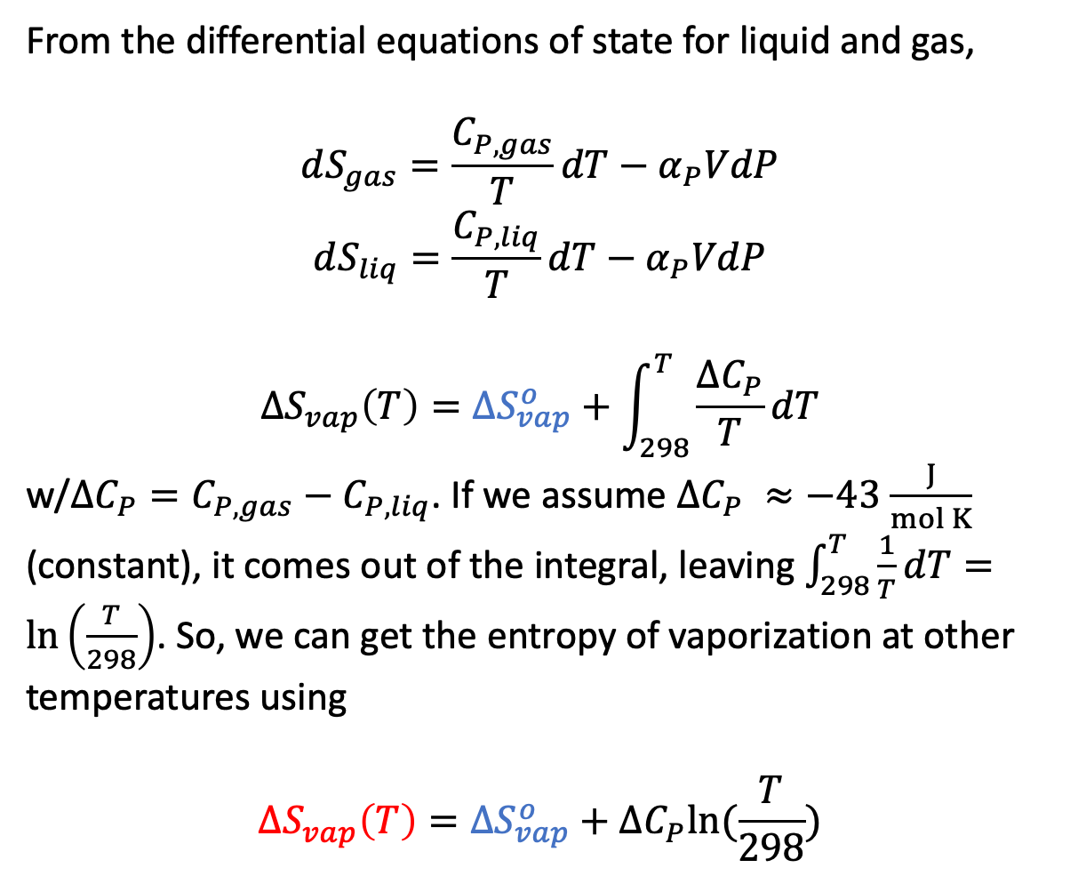

We know how to get $∆S_{vap}$ at other temperatures using heat capacities
From the differential equations of state for liquid and gas,
$$dS_{gas}=\frac{C_{P,gas}}{T}dT−α_{P}VdP$$
$$dS_{liq}=\frac{C_{P,liq}}{T}dT−α_{P}VdP$$
$${∆S}_{vap}\left(T\right)={∆S}_{vap}^{o}+\int_{298}^{T}{\frac{∆C_{P}}{T}dT}$$
w/$∆C_{P}=C_{P,gas}−C_{P,liq}$. If we assume $∆C_{P} ≈−43$ $\frac{J}{mol K}$ (constant), it comes out of the integral, leaving $\int_{298}^{T}{\frac{1}{T}dT}=\ln\left(\frac{T}{298}\right)$. So, we can get the entropy of vaporization at other temperatures using
$${∆S}_{vap}\left(T\right)={∆S}_{vap}^{o}+∆C_{P}ln⁡(\frac{T}{298})$$
$${∆S}_{vap}^{o}=118.7$$
$$109$$

Slide 16
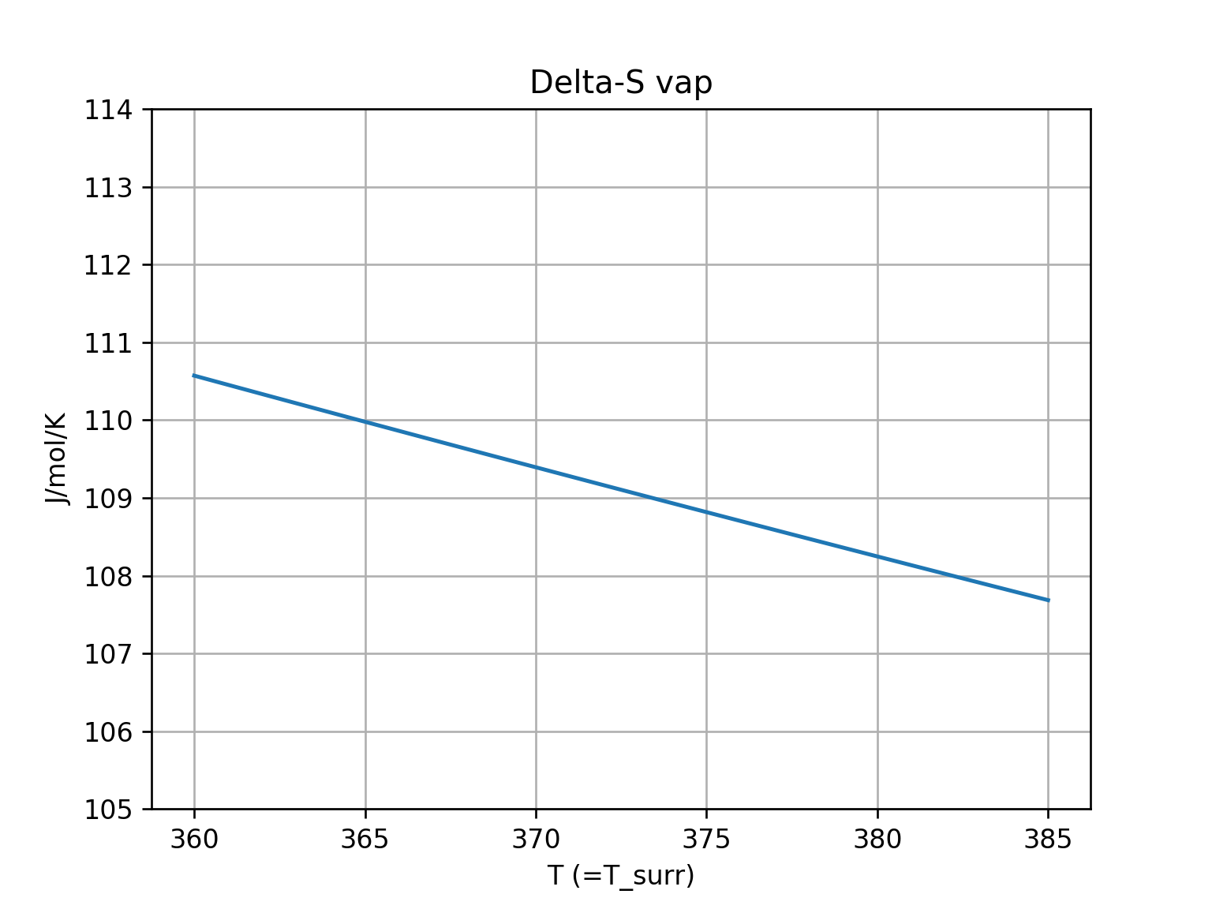
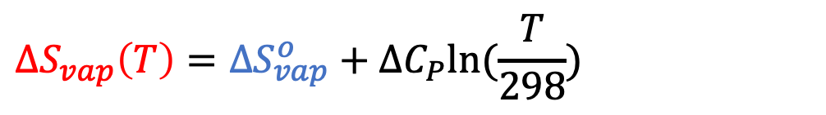

Since liquids have higher $C_{P}$ than gases, $∆S_{vap}$ generally gets smaller with increasing temperature
$${∆S}_{vap}\left(T\right)={∆S}_{vap}^{o}+∆C_{P}ln⁡(\frac{T}{298})$$
$${∆S}_{vap}^{o}=118.7$$
$$109$$
$${∆S}_{vap}\left(T\right)$$
slopes down

Slide 17
Scope of today’s work
Bomb calorimetry
Why enthalpy was invented
Entropy of phase transformations
How enthalpies of reaction tell us about entropy changes of the surroundings
2nd Law of Thermodynamics

Slide 18
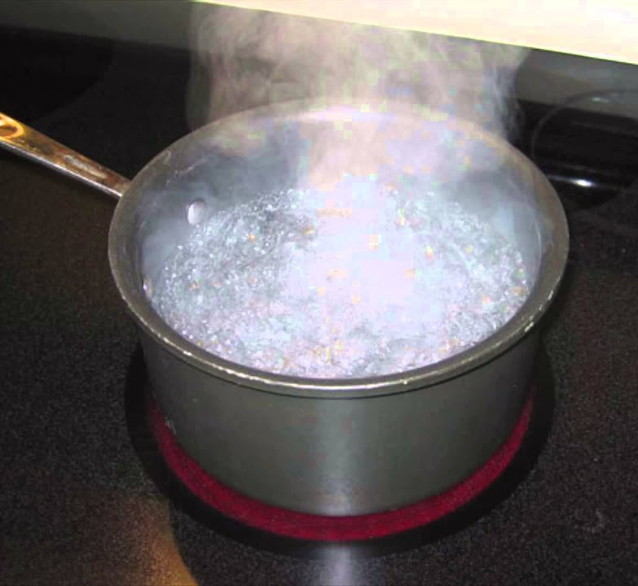
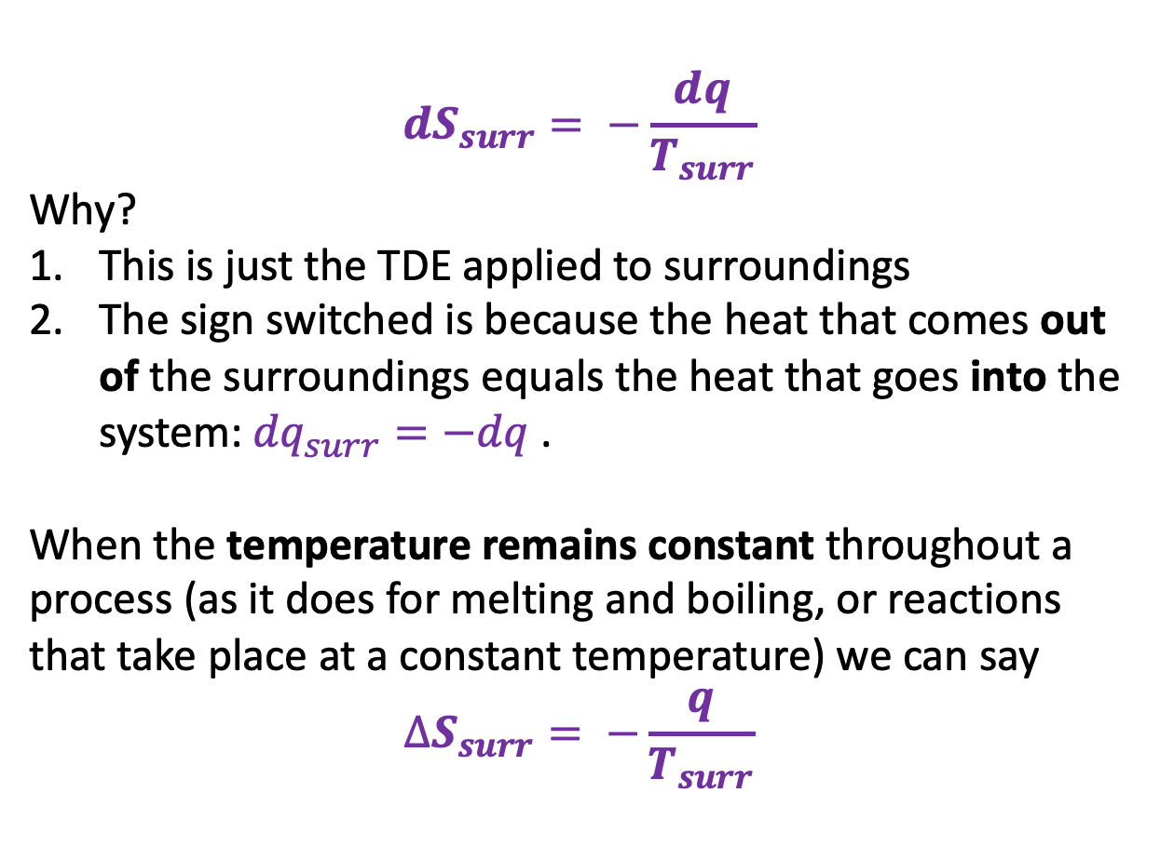
What about the entropy change of the surroundings ($∆S_{surr}$)?
$$dS_{surr}= −\frac{dq}{T_{surr}}$$
Why?
This is just the TDE applied to surroundings
The sign switched is because the heat that comes out of the surroundings equals the heat that goes into the system: ${dq}_{surr}=−dq$.
When the temperature remains constant throughout a process (as it does for melting and boiling, or reactions that take place at a constant temperature) we can say
$$∆S_{surr}= −\frac{q}{T_{surr}}$$
We can take this one step farther, knowing that $q=∆H$ for a constant-pressure process, we can say $∆S_{surr}= −\frac{∆H}{T_{surr}}$.

Slide 19
Scope of today’s work
Bomb calorimetry
Why enthalpy was invented
Entropy of phase transformations
How enthalpies of reaction tell us about entropy changes of the surroundings
2nd Law of Thermodynamics

Slide 20
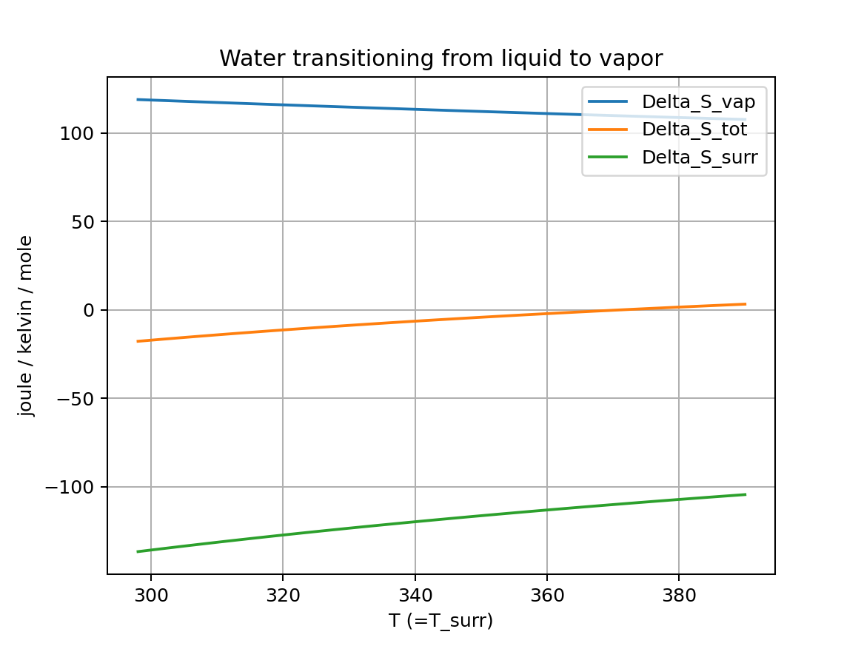
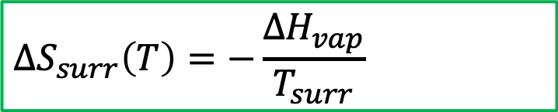
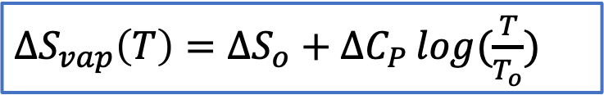



Putting these on the same scale and insisting on thermal equilibrium (so $T=T_{surr}$) …
${∆S}_{vap}\left(T\right)=∆S_{o}+∆C_{P }log⁡(\frac{T}{T_{o}})$
${∆S}_{vap}\left(T\right)$(system)
$${∆S}_{tot}\left(T\right)$$
$${∆S}_{surr}\left(T\right)$$
$${∆S}_{surr}\left(T\right)=−\frac{∆H_{vap}}{T_{surr}}$$

Slide 21
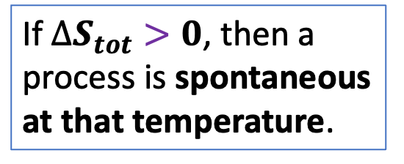
Putting these on the same scale and insisting on thermal equilibrium (so $T=T_{surr}$) …
${∆S}_{vap}\left(T\right)=∆S_{o}+∆C_{P }log⁡(\frac{T}{T_{o}})$
${∆S}_{vap}\left(T\right)$(system)
If $∆S_{tot}>0$, then a process is spontaneous at that temperature.
$${∆S}_{tot}\left(T\right)$$
$${∆S}_{surr}\left(T\right)$$
$${∆S}_{surr}\left(T\right)=−\frac{∆H_{vap}}{T_{surr}}$$

Slide 22
Putting these on the same scale and insisting on thermal equilibrium (so $T=T_{surr}$) …
${∆S}_{vap}\left(T\right)=∆S_{o}+∆C_{P }log⁡(\frac{T}{T_{o}})$
${∆S}_{vap}\left(T\right)$(system)
If $∆S_{tot}>0$, then a process is spontaneous at that temperature.
$${∆S}_{tot}\left(T\right)$$
$${∆S}_{surr}\left(T\right)$$
$${∆S}_{surr}\left(T\right)=−\frac{∆H_{vap}}{T_{surr}}$$

Slide 23
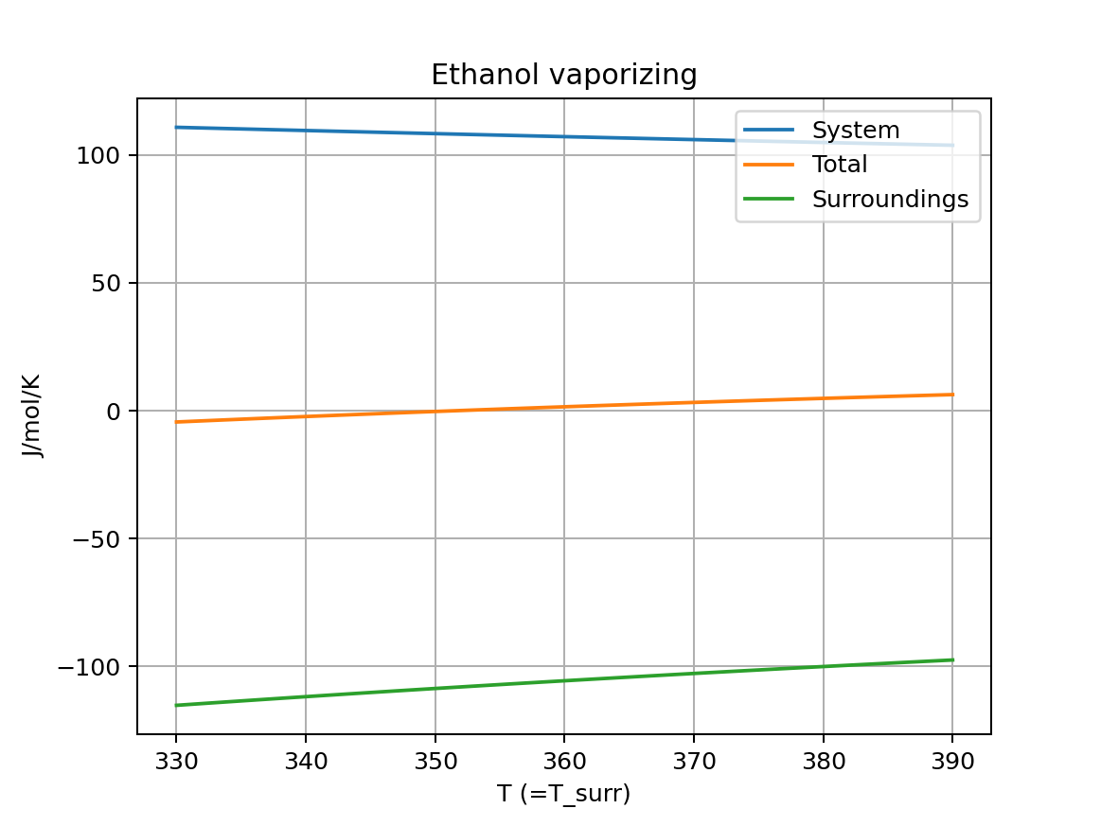


We can do this for other substances – like EtOH
${∆S}_{vap}\left(T\right)=∆S_{o}+∆C_{P }log⁡(\frac{T}{T_{o}})$
${∆S}_{vap}\left(T\right)$(system)
If $∆S_{tot}>0$, then a process is spontaneous at that temperature.
$${∆S}_{tot}\left(T\right)$$
$${∆S}_{surr}\left(T\right)=−\frac{∆H_{vap}}{T_{surr}}$$
$${∆S}_{surr}\left(T\right)$$

Slide 24

We can do this for melting too
$${∆S}_{fus}^{o}$$

Slide 25
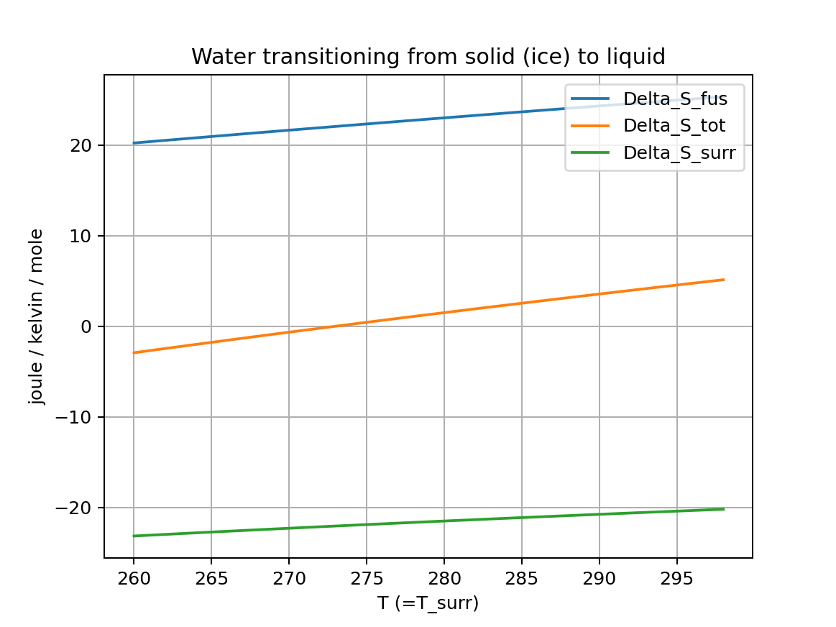


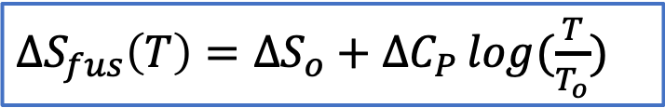

We can do this for melting too
${∆S}_{fus}\left(T\right)=∆S_{o}+∆C_{P }log⁡(\frac{T}{T_{o}})$
${∆S}_{fus}\left(T\right)$(system)
If $∆S_{tot}>0$, then a process is spontaneous at that temperature.
$${∆S}_{tot}\left(T\right)$$
$${∆S}_{surr}\left(T\right)$$
$${∆S}_{surr}\left(T\right)=−\frac{∆H_{fus}}{T_{surr}}$$

Slide 26
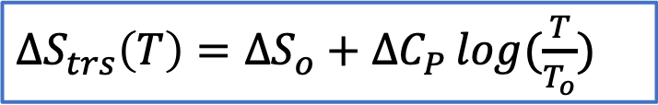


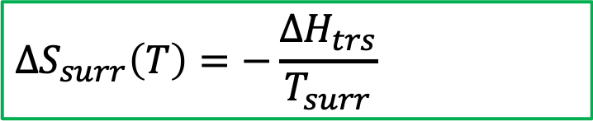
A more general notation for 2nd Law as applied to phase transformations (using “trs”)
${∆S}_{trs}\left(T\right)=∆S_{o}+∆C_{P }log⁡(\frac{T}{T_{o}})$
If $∆S_{tot}>0$, then a process is spontaneous at that temperature.
$${∆S}_{tot}\left(T\right)$$
$${∆S}_{surr}\left(T\right)=−\frac{∆H_{trs}}{T_{surr}}$$

Slide 27
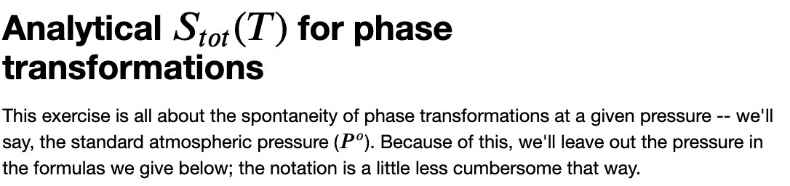
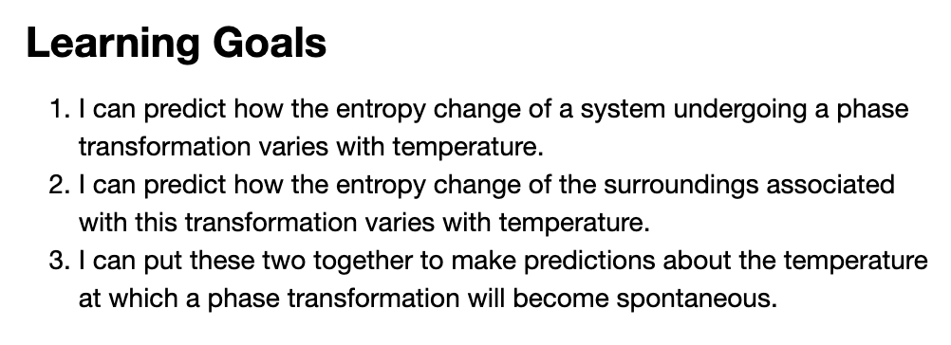
OK, let’s get started

